Slide 1
Reinforcement Learning
Keith Burghardt, Kristina Lerman
University of Southern California
Slides adapted from Professor Wei-Min

Slide 2
Outline
Agent and Environment
States, actions, utility, rewards, policy
Utility value iteration
Policy iteraction
Reinforcement Learning
Model-based
Model-free
Q-Learning
For state space and for game playing
Deep reinforcement learning

Slide 3
A Motivating Example
Imagine we want to make a language model, in which we give it plain text questions and it will give us answers
“What is the largest prime less than 10?”
“When should dinner be ready?”
“What should I do today?”
…
How can you make a model that can understand what this text means?
We only mean that this text can map the question to a most likely answer, and is typically right
We do not mean if the model can “understand” in the sense of “think”
https://medium.com/huggingface/learning-meaning-in-natural-language-processing-the-semantics-mega-thread-9c0332dfe28e

Slide 4


Slide 5


Slide 6
Questions To Think About
Is raw text all we need to teach a model?
“The Nile is the longest river…”
what happens if you know all the text in the world...
and therefore lexicon, grammar, …
Can you make *sense* of language?
If not, how might you teach AI meaning in language?

Slide 7
One Solution: Reinforcement Learning
Assume you have a language model that tries to maximize a utility function (i.e., some value)
You give your hypothetical language model a task, e.g., given everything it knows, is it faster to rollerblade in grass or gravel?
It can spit out an answer, e.g. either at random, and you reward or punish the model (increase or decrease the utility) depending on the output

Slide 8
Hypothetical Outcome
It’s possible, but not guaranteed, that the model is able to generalize from what it was taught
This is alike to human learning: if you are learning a new language, but do not understand its meaning, you could
A: repeat text that you know tends to follow a question by your instructor without understanding or knowledge about whether this is what the instructor wants
B: the instructor can tell you if your answers are correct or not, and you aim to maximize your grade. You could in principle learn what patterns make the grade, and therefore learn the language
But fundamentally, you may not understand what the language is saying, only what you are supposed to say to best answer the question
This is alike to “The Chinese Room” argument in computer science, c.f., https://en.wikipedia.org/wiki/Chinese_room

Slide 9

General Reinforcement Learning
https://en.wikipedia.org/wiki/Reinforcement_learning

Slide 10
What model sees

Slide 11
Interpret what you see to change model state
reward or punish model’s action

Slide 12
Agent is the model itself
It directs actions, e.g., what to do or what to say
Its actions are based on its internal state
It changes actions based on rewards

Slide 13
Why do we need all these states?
What if we
remove
reward?

Slide 14
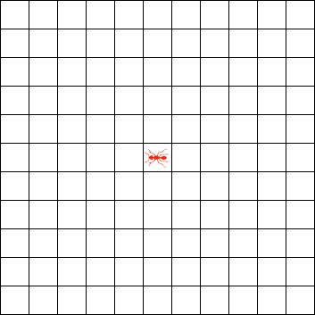
Example of Movement Without Rewards
Langton’s ant:
Environment: colors of surrounding blocks
State depends on local environment
New state = new action (move forward, turn left, or right)
Note: no reward for movement

Slide 15

Example

Slide 16
Movement With Purpose
Rewards push a model to a particular action
Example: Langton’s ants will not a priori try to find the closest distance between two points
However, real ants will!
Ants leave pheromones (change the environment)
Pheromones are sensed by ants (observer)
They follow pheromones (action) because they want to follow food/home (increases their “utility”)
new state -> new action
As better routes are found, pheromones reinforce shortest path

Slide 17
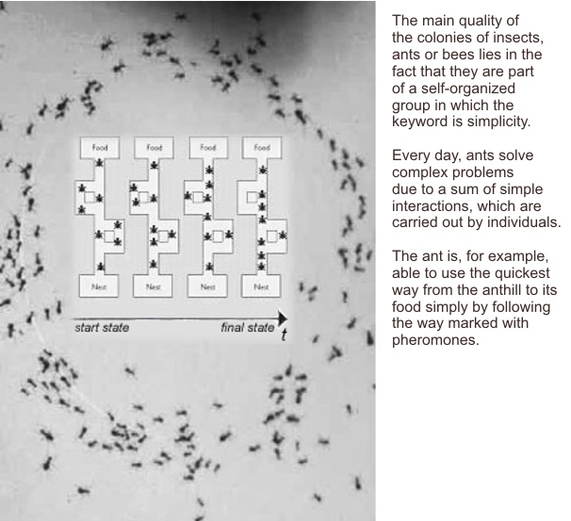
https://en.wikipedia.org/wiki/Ant_colony_optimization_algorithms

Slide 18
Basics of Reinforcement Learning
Markov decision process (MDP):
a set of environment and agent states, S;
a set of actions, A, of the agent;
Movement is generally stochastic
Probability to do action a given state s: Pr ( a_{t}= a ∣ s_{t} =s)
Probability to move from state s to s’, given action a: Pr ( s_{t+1}= s ′ ∣ s_{t} =s , a_{t} = a )
Reward from s to s’ (independent of what action was taken): R_{a}(s,s′)
https://en.wikipedia.org/wiki/Reinforcement_learning

Slide 19
Goal
Maximize cumulative rewards
Ant example:
Maximize the pheromones smelled (signals they find way to food/home)
Random/bad movements are discouraged because the pheromones are not reinforced
Collective action = fastest path

Slide 20
Exploration vs. Exploitation
A common issue in these methods is exploring versus exploiting actions/environments
Explore:
Pro: potentially reach new beneficial scenarios
Con: Encounter low-reward environments/actions
Exploit:
Pro: if it ain’t broke, don’t fix it (you know this probably works)
Con: opportunity loss

Slide 21

Multi-Armed Bandits

Slide 22
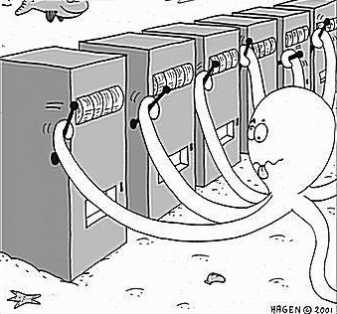
Multi-Armed Bandits
Quintessential example of exploring vs exploiting in reinforcement learning
What are bandits?
A.k.a. slot machines: pull arm and pay money to gain reward
Question: what bandits/slot machines give you the best average pay-off?
This is a hidden reinforcement learning problem:
Learn what strategies are best (what lever to pull) based on reward (payoff)
https://www.analyticsvidhya.com/blog/2018/09/reinforcement-multi-armed-bandit-scratch-python/

Slide 23
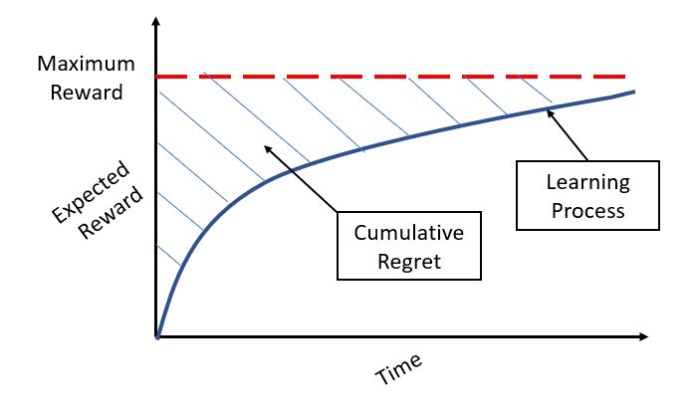
Good versus best strategies
https://www.analyticsvidhya.com/blog/2018/09/reinforcement-multi-armed-bandit-scratch-python/

Slide 24
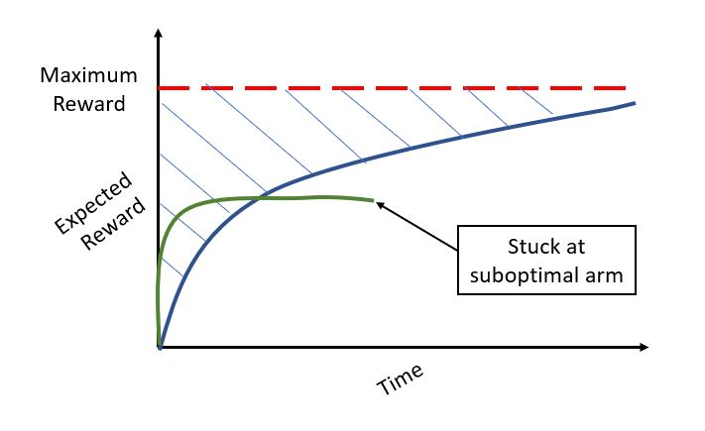
“Too careful” strategies

Slide 25
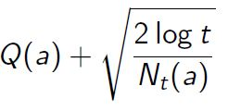
Naive and nuanced methods
Naive
Pick at random
Pick just 1 (see what worked in past, stick with it)
Epsilon-Greedy: pick best, but with probability epsilon pick a random arm
Nuanced
Upper confidence bound: given round t, and number of times N method is chosen, pick arm with best reward

Slide 26
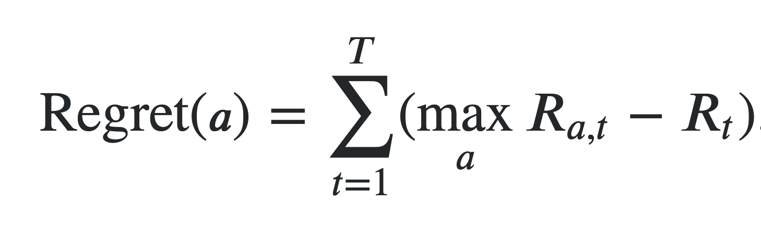
Fundamental Trade-Offs: Regret
Regret is the cumulative of the difference between the best reward the current reward
Minimizing regret = finding best general actions, so you tend to do near-optimally

Slide 27
Fundamental Trade-Offs:
Explore vs Exploit
So how do we find the lowest regret?
Regret depends on actions
We won’t know what actions are harmful or helpful until we try them
Example: touching oven as a child = harm
Example: getting a degree. Harm = cost, benefit = skills (typically the good outweighs the bad)
Explore = try new actions/move to new environments
We might find high rewards or might make harmful action
Exploit = work with tried and tested methods
“safe” but potentially high regret

Slide 28
What Defines a “Good” Set of Actions?
Policy: set of probable actions Pr(a_{t} = a|s_{t} = s)
Assume actions only depend on current state
Example: in chess, we usually consider states (what pieces are on the board) independent of when they were played
A “good” state = a state that maximizes future expected rewards

Slide 29
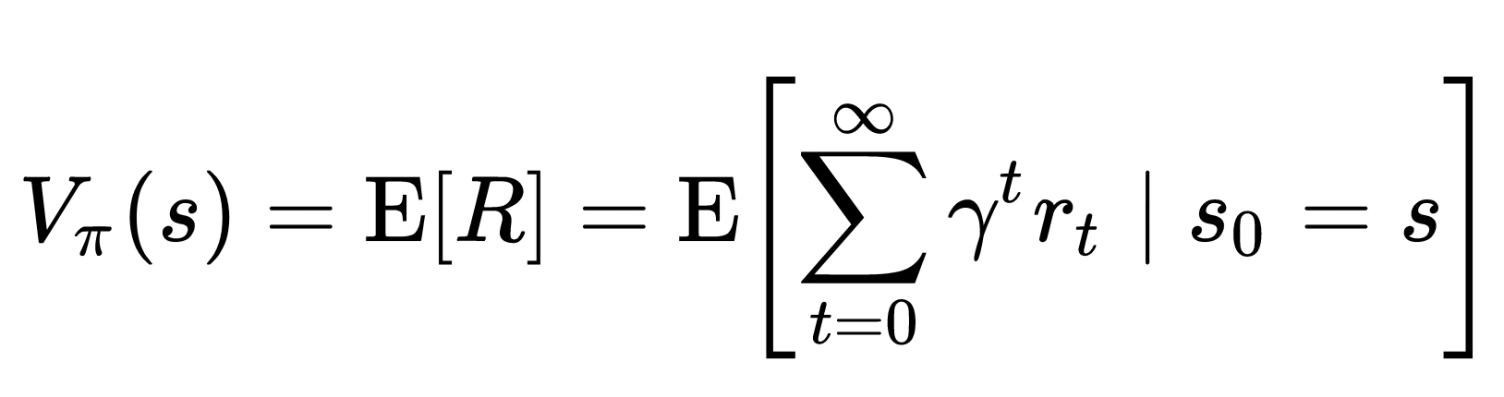
Expected Reward
Expected future rewards = cumulative future payoff
Note, all rewards are weighted by “gamma” to the “t”, where gamma <= 1
This means we put more weight on immediate actions than future ones
Gamma = 0: actions independent of expected reward
Gamma = 0.00…001: greedy method
Gamma = 1: all of future is important

Slide 30
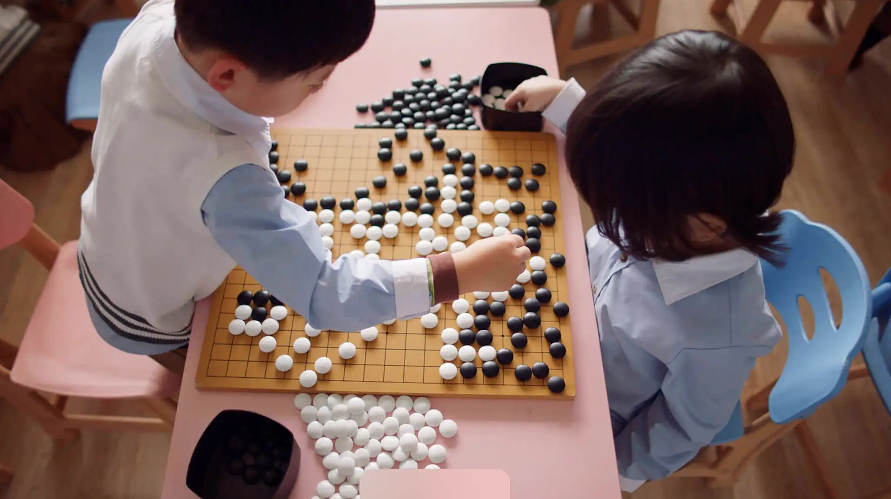
Application
Alpha Go: Neural Network that finds best moves in the game Go
This was a game changer (literally!)
Number of “states” (board outcomes) is enormous

Slide 31
Fundamental Problems
Given enormous number of states, how do we know the rewards of a particular action?
“value network” = neural network to predict rewards (who will be winner)
What action to take?
“policy network” = best policy for each state
How to determine rewards
Seeded many games with known outcomes

Slide 32
Networks Are Not Brains
What made the algorithm so unusual is the reward function: probability of winning
Different reward functions create different outcomes
Humans cannot know for certain if they will win, so they use a proxy, the amount of “territory” they control
This is a good proxy, but not optimal

Slide 33
Applications: Robots
Robots: need to know if they are doing something correctly
Ex: Self-Driving Cars
Even if car knows what is a tree or human, it must learn what it should and should not hit
Problems to solve:
What are actions
What is the state space (i.e., what are possible things we might encounter)
What is reward
Kiran et al., 2021

Slide 34
Solutions
Reinforcement learning
Naive
Nuanced
Deep reinforcement learning
What is so “deep” about it?
Different methods

Slide 35
How do we maximize these rewards
Naive method: “greedy” optimization
Assume we want to find best immediate path
This is not always the best path
Example: reward or punish model that answers questions correctly
If you in a few questions a model is rewarded when it knows “baskets” have “eggs” in them (immediate reward, R), it should not always assume that (action, a) to maximize its cumulative reward
How should we train models to perform best?

Slide 36
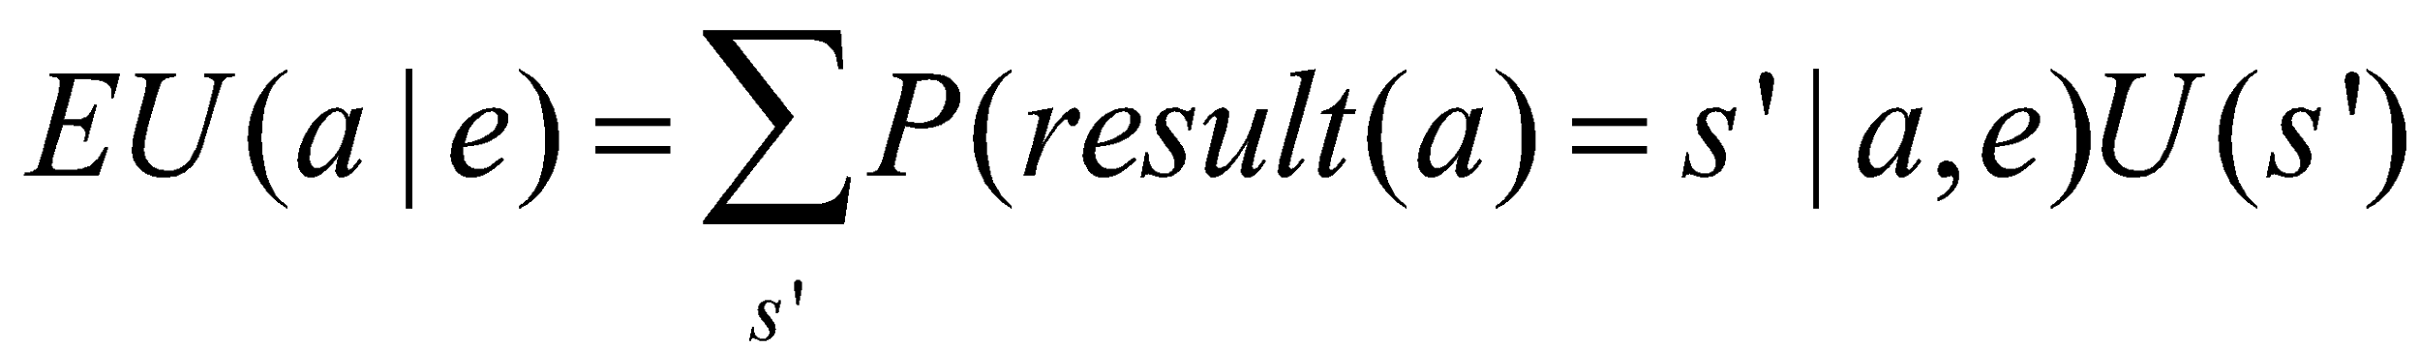
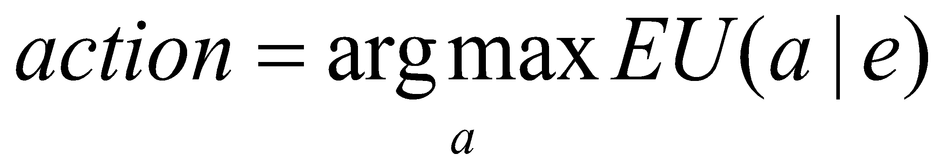
Maximum Expected Utility (MEU) and Rational Agents
Every state has a utility value U(s)
The expected utility of an action given the current evidence or observation e, is the average utility value of the outcomes, weighted by the probability that the outcome occurs:
The principle of maximum expected utility (MEU) is that a rational agent should choose the action that maximizes its expected utility:
z2
z1
s2
a1
s9
U(s2)=0.4
a1
U(s9)=0.2
a1
s7
U(s7)=0.4

Slide 37
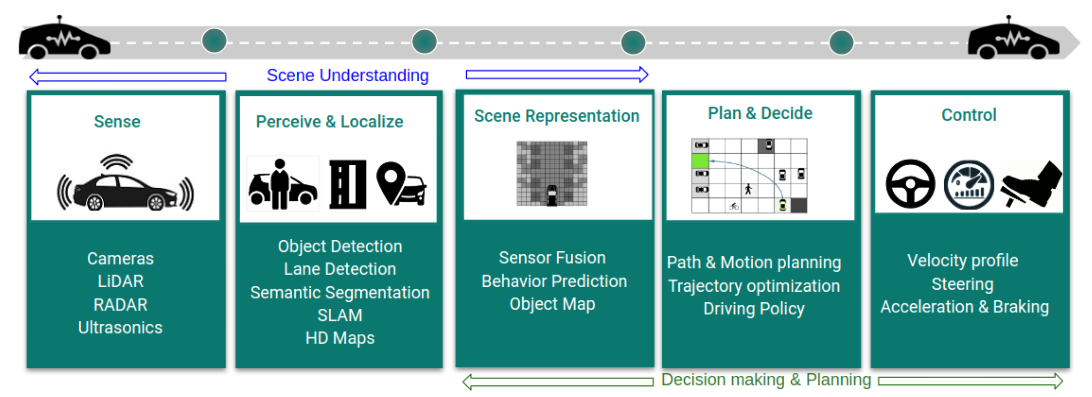
Deep Reinforcement Learning
AI Driving
Kiran et al. Deep Reinforcement Learning for Autonomous Driving: A Survey. (2021)

Slide 38
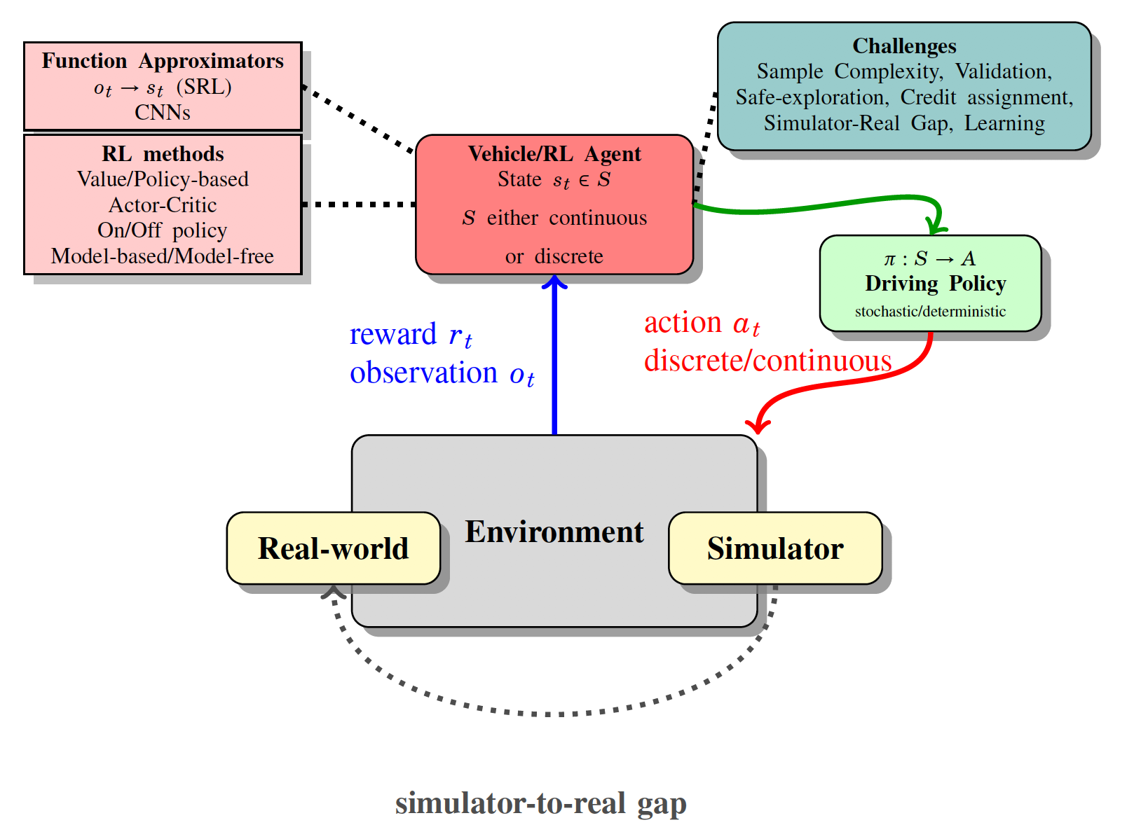
How Self-Driving Cars Work

Slide 39
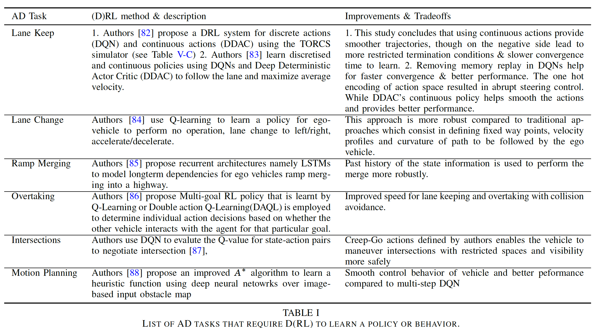
Self-Driving Tasks And Methods

Slide 40
Why we need Deep RL
Curse of dimensionality:
How to train on all the edge cases
E.g., someone unexpectedly cuts you off in particularly rainy or snowy night
Need model to work well with (amount of rain)x(day/night)x(number of cars)x(type of road)... (exponentially large space)
In theory any model could handle this if we have enough data (but data is not always available, especially for rare circumstances)

Slide 41
Deep RL
Goal is to generalize from what we learned to edge cases
Similar to student drivers: we don’t learn all scenarios that come our way, but we can still handle most of them
How do these methods work?

Slide 42
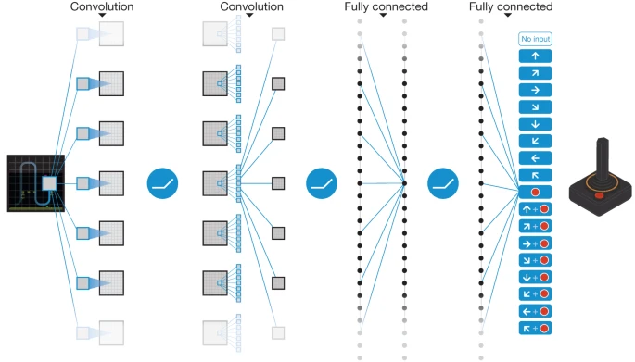
Case Study: Deep Q-Network (DQN)

Slide 43
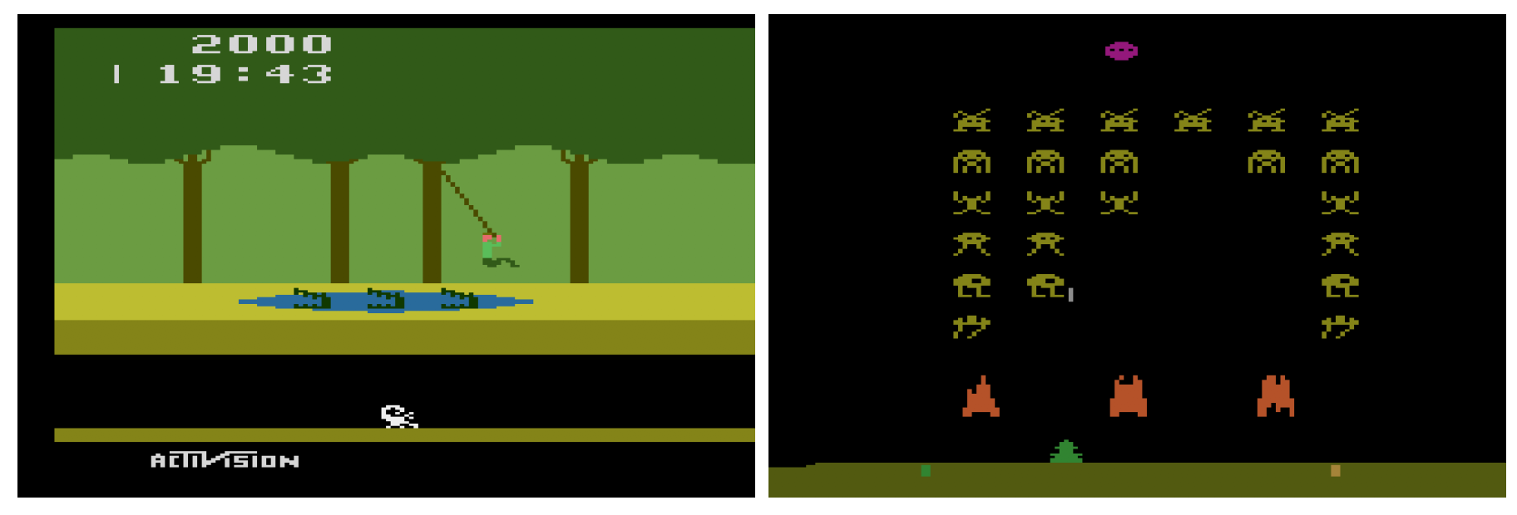
DQN Benchmark
Try to excel at Atari 2600 Games (benchmark challenge: Bellemare et al., 2012)

Slide 44
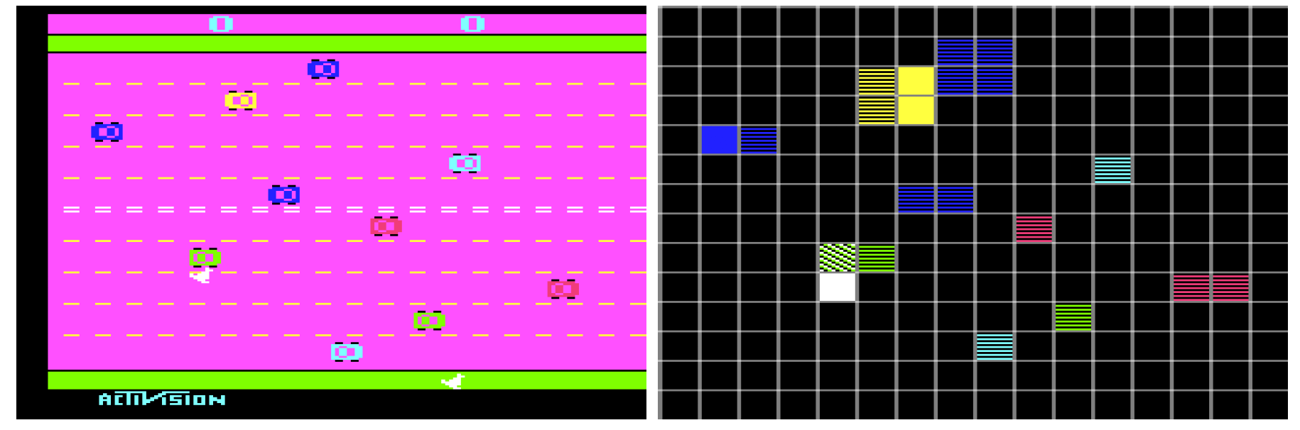
Why Atari Games?
Easy to evaluate (score)
Requires high skill
Compare to experienced humans

Slide 45
DQN
Interact with environment
Actions (movement on screen)
Rewards (score)
Read in pixelated screen with 60 hz update
Use history of past movements to determine reward of potential actions, and best action to take

Slide 46
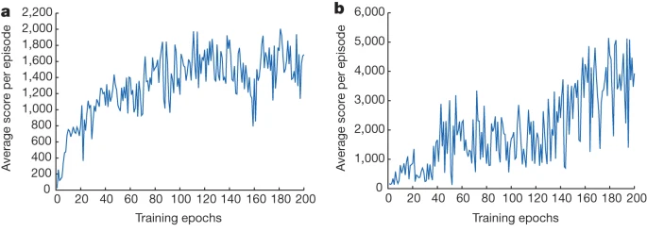
Training Over Time: Improved Score
Note that scores do not strictly improve. The goal is to improve in aggregate, even if near-term changes are deleterious

Slide 47
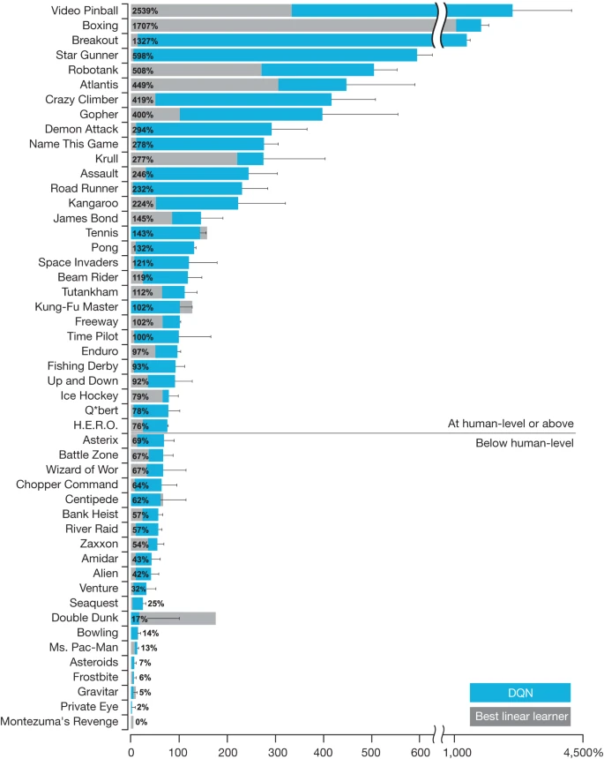
Method Equal or better than humans in many games!

Slide 48
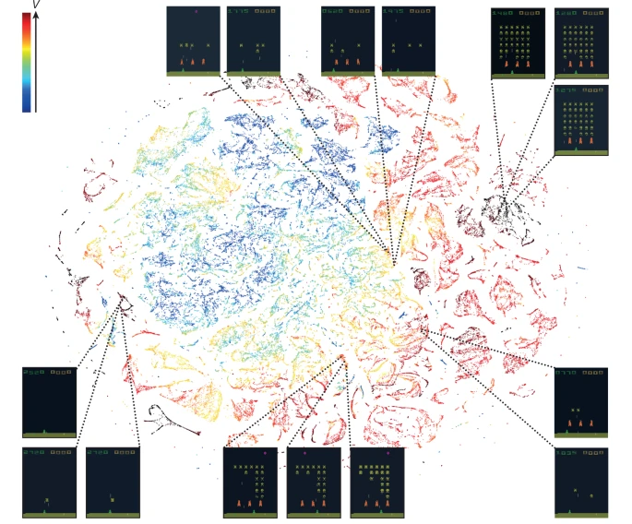
Mapping Scenarios to Rewards

Slide 49
How DRN Works
High-dimensional data makes determining state, reward difficult (large state space)
How do we predict cost of moving self-driving car too quickly around corner (how might this affect the chance we will hit a pedestrian?)
These models create 2 networks
Value network (benefit of each action)
NNs are very good at making sense of large action space
Policy network (what is the best action for a given state)
Many potential moves one can make, and we may need to explore (do something that is sub-optimal) in order to learn new utility functions - how best to do this is the benefit of a NN

Slide 50
REINFORCEMENT LEARNING: Details of Decision-Making

Slide 51
Markov Decision Process
Markov Decision Process
We learned that a Markov Decision Process (MDP) consists of
A set of states S (with an initial state s₀)
A set of actions A in each state,
A set of percepts that can be sensed
A transition model P(s’|s,a), or T(s,a,s’)
A sensor model θ = P(z|s)
The current state distribution
A reward function R(s,a,s’)
The MDP’s solution identifies the best action to take in each state
Optimal policy π(s)=a obtained by value iteration or policy iteration (aka dynamic programming)

Slide 52
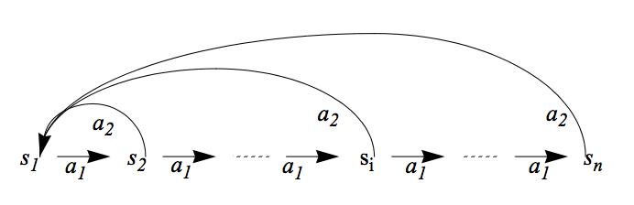
An Example for MDP
Given
States: s₁, …, s_{n,} Actions: a₁, a₂
Transition Probability Distribution: (assume s_{n+1}=s₁)
P(s_{i},a₁,s_{i+1})=0.8, P(s_{i},a₁,s₁)=0.2, P(s_{i},a₂,s₁)=0.9, P(s_{i},a₂,s_{i+1})=0.1.
Reward: all R(s_{i}, a_{i}, s_{j}) = 0.0, except R(s_{n-1}, a₁, s_{n}) = 99.9
We define the goal state to be s_{n}
The Future discount factor: gamma = 0.7
State utility values: U(s_{n-1}), U(s_{n-2}), U(s_{n-3}), … and U(s₂), U(s₁)
Optimal Policy: π(s_{i})=a₁
99.9
Goal

Slide 53
Reinforcement Learning
Given a Markov Decision Process (environment)
A set of states S ✔ (known)
A set of actions A in each state ✔ (known)
A set of percepts that can be sensed ✔ (known)
The current state ✔ (known)
Transitions P(s’| s, a) ✖ (only known by the env)
Rewards R(s, a, s’) ✖ (only known by the env)
Could the agent still learn the optimal policy?

Slide 54
Goals, Rewards, Utilities, Policies
Goals
Given to the agent from the problem statements
Rewards
Given to the agent, designed based on the goals
Utility values for states
Computed by the agent, based on the rewards
Policies
Computed or learned by the agent
Used by the agent to select its actions
The better a policy, the more rewards it collects

Slide 55
Reinforcement Learning Propagating the Delayed Rewards
G
G
Before RL
After RL
After RL, no matter where you are, you know which way to go to the Goal!

Slide 56
Reinforcement Learning (Key Ideas)
Can the agent still learn the optimal policy?
When it knows only the states S and actions A, but not the transition model P(s,a,s’) and/or reward function R(s,a,s’)
Try an action on a state of the environment, and get a “sample” that includes (s, a, s’, r) and maybe U:
A state transition (s,a)🡪s’
A reward received for the action r = R(s, a, s’)
And maybe the utility value of the next state U(s’)
Objective: Try different actions in states to discover an optimal policy π(s)=a and eventually tells the agent which action will lead to the most rewarding states

Slide 57
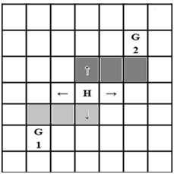
How to Explore the State Space
Visit different states to discover a policy and improve it
Numerous strategies
A simple strategy is executing actions randomly
Initially there is no policy, but random actions eventually discover a policy
At every time step, act randomly with a probability (for exploration), otherwise, follow the current policy π(s)=a
The random action may causes unnecessary action execution when the optimal policy is already discovered
One solution is to lower the probability of selecting a random action over time (reduce the “temperature”)
We clearly see connections to potential strategies seen in the Multi-Armed Bandit problem!

Slide 58
Reinforcement Learning
Objective: Learn the optimal policy π*(s)=a
Two general classes of algorithms:
Model-based RL
First learn the transition model and the utility values of states, then learn the policy (e.g., policy iteration)
Example from chess: learn the likely moves opponents will make (transition) when you make your move (action) and the reward (whether you will eventually win, be up pieces, etc.)
Model-free RL
Learn the policy without learning an explicit transition model, but by receiving “samples” from the environment
Example from chess: learn whether each action is beneficial or not by playing the game. Opponent’s moves are a black box.
Three algorithms we will learn:
Monte Carlo
Temporal Difference
Q-Learning

Slide 59
An Example for Model-Based RL
Given
States: s₁, …, s_{n,}
Actions: a₁, a₂
Probabilistic transition model: (assume s_{n+1}=s₁)
P(s_{i},a₁,s_{i+1})=0.8, P(s_{i},a₁,s₁)=0.2, P(s_{i},a₂,s₁)=0.9, P(s_{i},a₁,s_{i+1})=0.1.
Reward: all R(s_{i}, a_{i}, s_{j}) = 0.0, except R(s_{n-1}, a₁, s_{n}) = 99.9
Future discount factor: γ = 0.7
Try to learn: U(s_{n-1}), U(s_{n-2}), U(s_{n-3}), … and U(s₂), U(s₁)
99.9

Slide 60
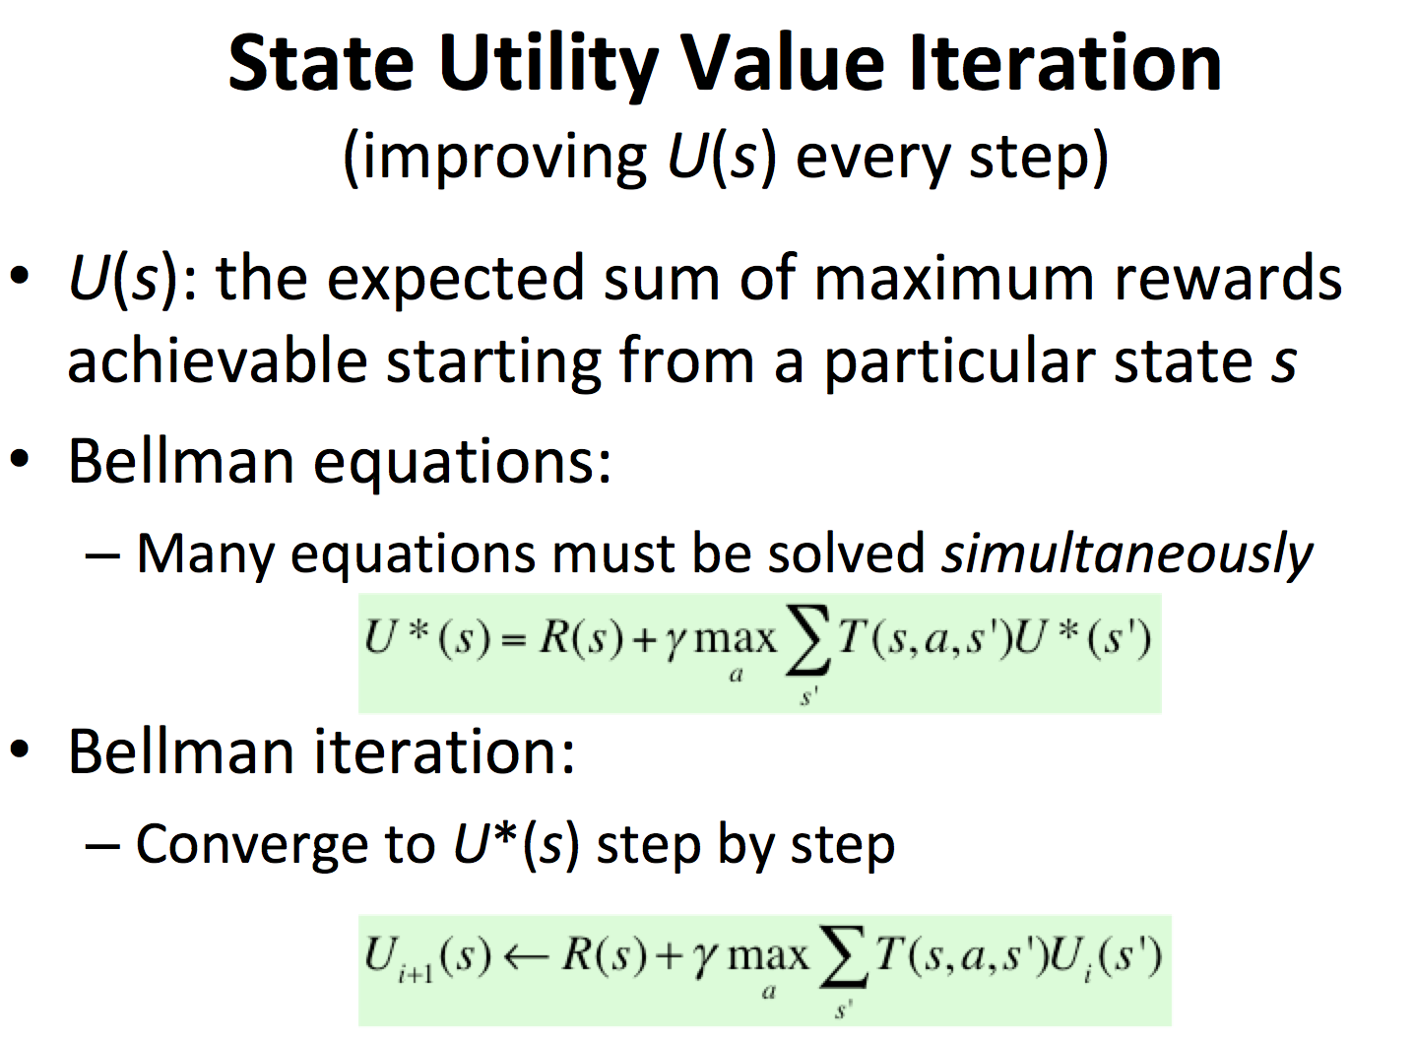
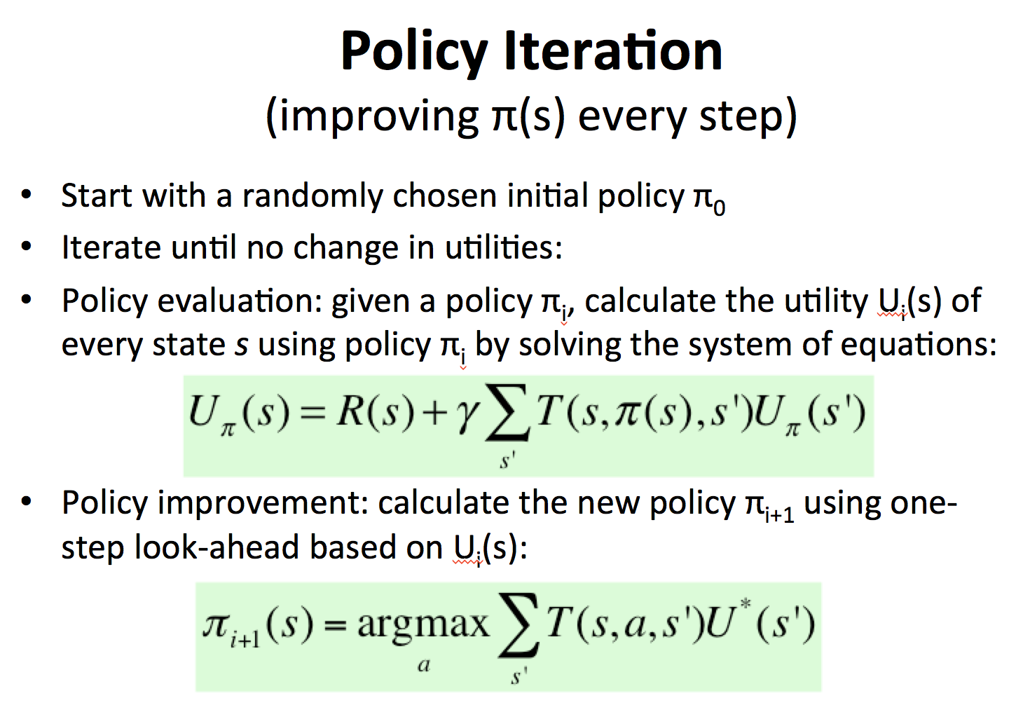
Model-Based RL
Learn an approximate model based on random actions
From a state s, count outcomes of s’ for each (s, a)
Normalize to give an estimate of P(s, a, s’)
Learn state utility U(s) from rewards R(s, a, s’) when encountered
Learn a policy (e.g., policy iteration) and solve the MDP

Slide 61
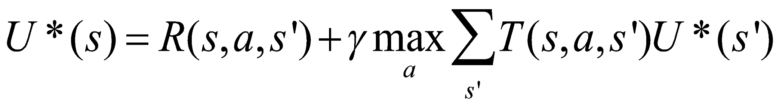
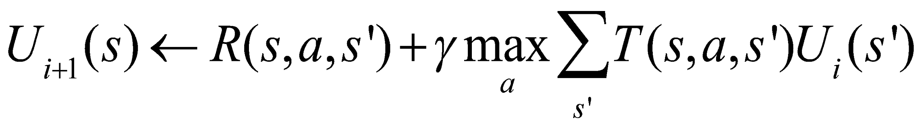
State Utility Value Iteration (review) (improving U(s) every step)
U(s): the expected sum of maximum rewards achievable starting from a particular state s
Bellman equations:
Many equations must be solved simultaneously
Bellman iteration:
Converge to U*(s) step by step

Slide 62
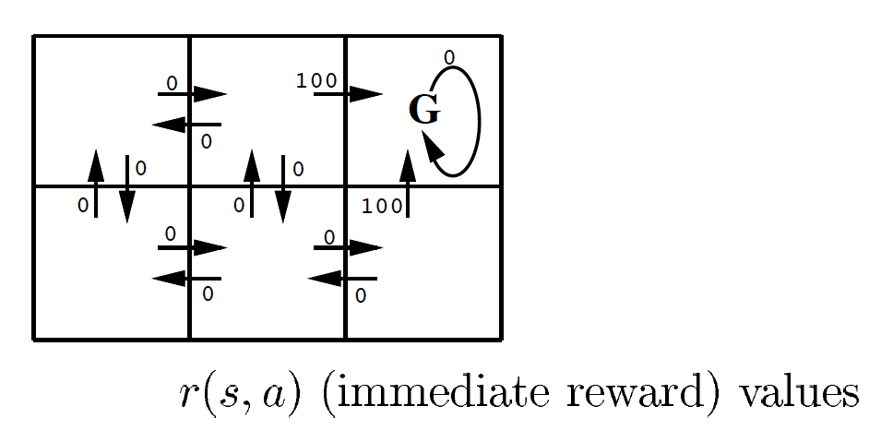
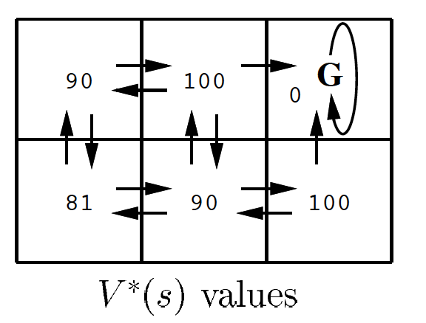
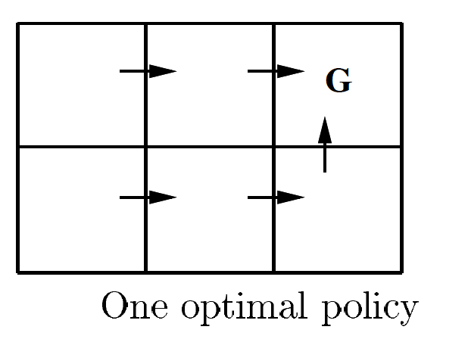
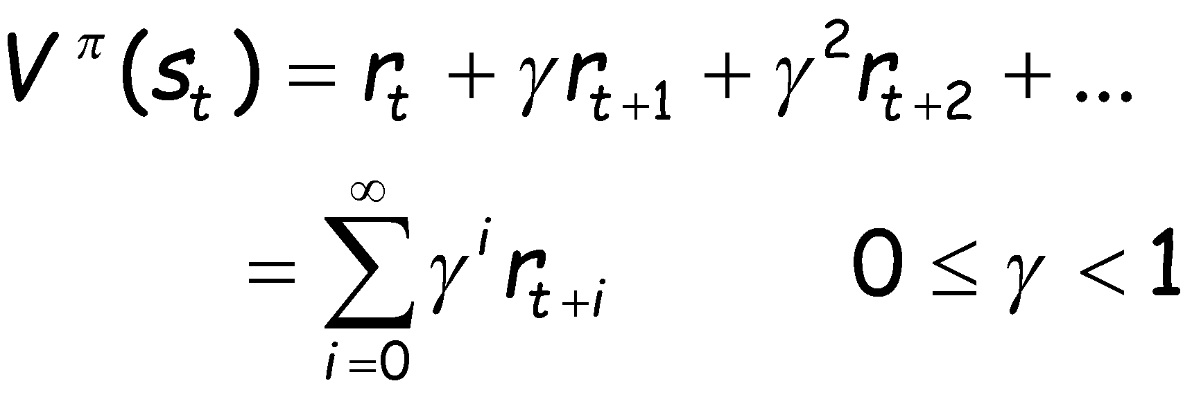
Utility Value Iteration (example)
Find your way to the goal
Use Bellman Iteration to compute state values from rewards
γ=0.9

Slide 63
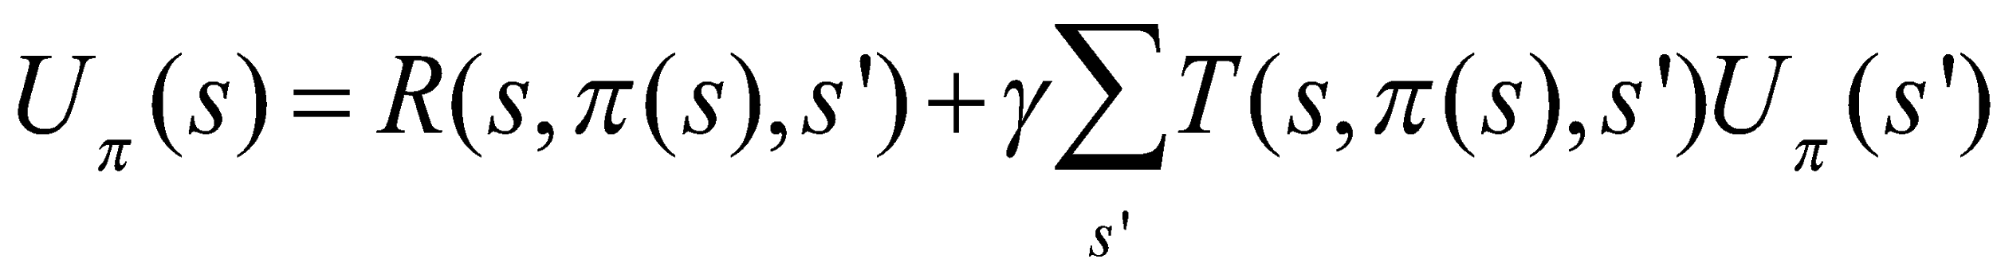
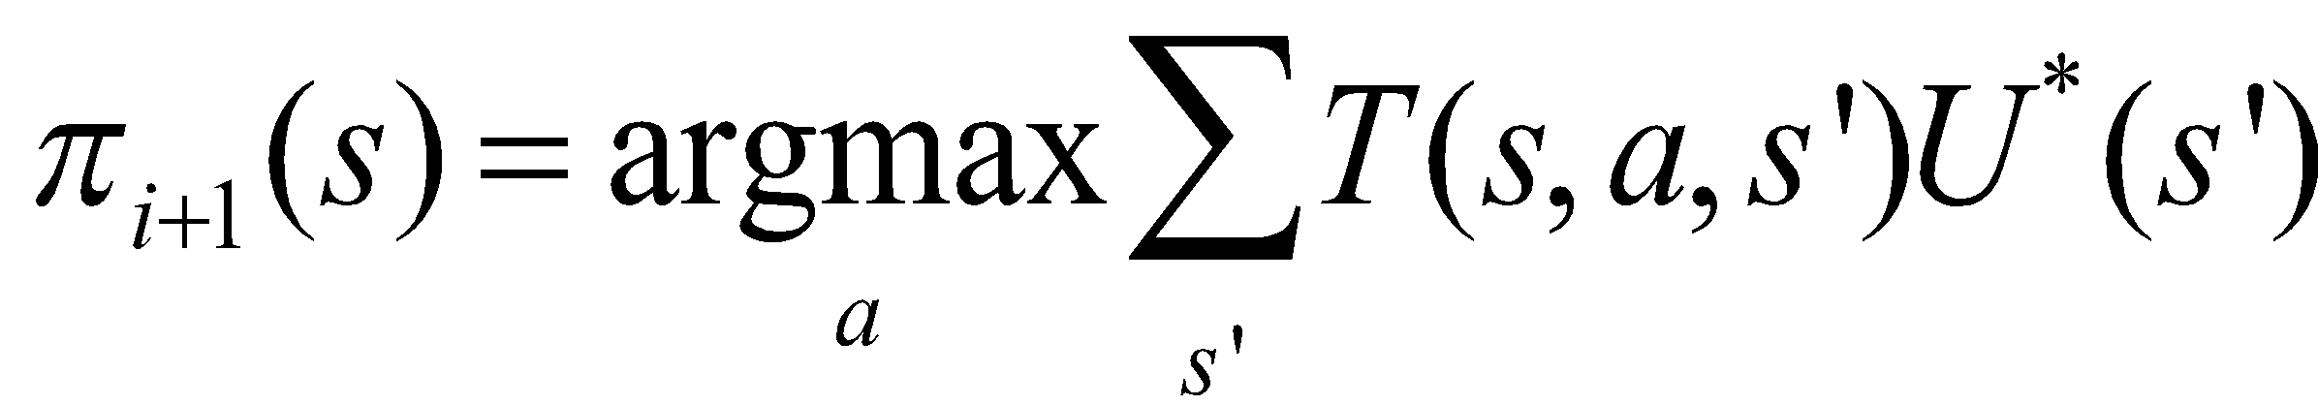
Policy Iteration (review) (improving π(s) every step)
Start with a randomly chosen initial policy π₀
Iterate until no change in the utility values of the states:
Policy evaluation: given a policy π_{i}, calculate the utility value U_{i}(s) of every state s using policy π_{i} by solving the system of equations:
Policy improvement: calculate the new policy π_{i+1} using one‐step look‐ahead based on U_{i}(s):

Slide 64
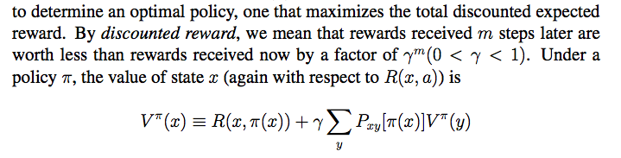
Compute Utility from Rewards and Policy
Transition: P(y|x,a)
P_{xy}[a]
y₁
V(y₁)
Assume the transitions are known
V(x)
x
y₂
V(y₂)
Rewards: R(x,a)
Policy: a=π(x)
y_{l}
V(y_{j})

Slide 65
An Example for Model-Based RL
Given
States: s₁, …, s_{n,}
Actions: a₁, a₂
Probabilistic transition model: (assume s_{n+1}=s₁)
P(s_{i},a₁,s_{i+1})=0.8, P(s_{i},a₁,s₁)=0.2, P(s_{i},a₂,s₁)=0.9, P(s_{i},a₁,s_{i+1})=0.1.
Reward: all R(s_{i}, a_{i}, s_{j}) = 0.0, except R(s_{n-1}, a₁, s_{n}) = 99.9
We define the goal state to be s_{n}
Future discount factor: γ = 0.7
U(s_{n-1})=99.9, U(s_{n-2})~=70, U(s_{n-3})~=49, … and U(s₁)~=99.9*0.7^{n}
99.9

Slide 66
Model-Based RL
Learn an approximate model based on random actions
From a state s, count outcomes of s’ for each (s, a)
Normalize to give an estimate of P(s, a, s’)
Learn state utility U(s) from rewards R(s, a, s’) when encountered
Solve the learned MDP and obtain a policy (e.g. policy iteration)
Pros:
If and when the goal changes, one can use the learned model P(s, a, s’) to recalculate U(s) and compute a new policy offline
Cons:
Larger representation than model-free RL

Slide 67
Model-Free Reinforcement Learning
Objective: Learn the optimal policy π*(s)=a
Model-based RL
First learn the transition model and the utility values of states, then learn the policy (e.g., policy iteration)
Model-free RL
Learn the policy without learning an explicit model, but by receiving “samples” from the environment
Three algorithms we will learn:
Monte Carlo
Temporal Difference
Q-Learning

Slide 68
Monte Carlo RL (model free)
Generate a fixed policy π(s) = a based on U(s)
In each episode, the learner follows the policy starting at a random state
Average the sampled returns originating from each state
Generate a policy based on U(s) as in “policy iteration”
Cons:
The utility value of states U(s) is given and fixed (not learned)
Works only in episodic problems
Takes a very long time to converge as learning is from complete sample returns
Wastes information as it figures out state values in isolation from other states

Slide 69
Temporal Difference RL (model free)
Improve Monte Carlo, still using a fixed policy
Update U(s) using each sample (s, a, s’, r) received from the environment and each sample includes:
A state transition (s,a)🡪s’ done by the environment
A reward received for the action r = R(s, a, s’)
And the value of the next state U(s’)
That is, Sample = r + γU(s’), where γ = future discount
TD Algorithm:
U(s) ← (1-α)U(s) + α*Sample = (1-α)U(s) + α[r+γU(s’)]
Where α is the “learning rate” (how much you trust the sample)
You might decrease α over time when converges to the average
The parameter α also represents “forgetting long past values”
Cons:
Only provides the utility values of states, not improve policy directly

Slide 70
An Example for TD-RL
Given
States: s₁, …, s_{n,}
Actions: a₁, a₂
Probabilistic transition model: (assume s_{n+1}=s₁)
P(s_{i},a₁,s_{i+1})=0.8, P(s_{i},a₁,s₁)=0.2, P(s_{i},a₂,s₁)=0.9, P(s_{i},a₁,s_{i+1})=0.1.
Reward: all R(s_{i}, a_{i}, s_{j}) = 0.0, except R(s_{n-1}, a₁, s_{n}) = 99.9
We define the goal state to be s_{n}
The learning rate α = 0.4
The Future discount factor: γ = 0.7
Use TD algorithm to learn: U(s_{n-1}), U(s_{n-2}), U(s_{n-3}), … and U(s₂), U(s₁)
99.9

Slide 71
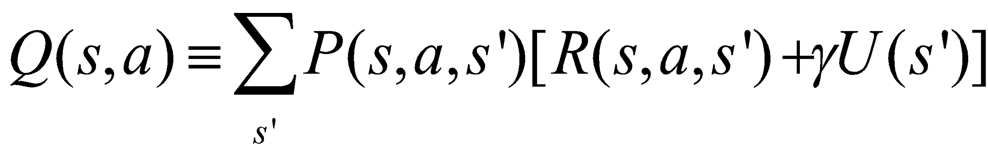
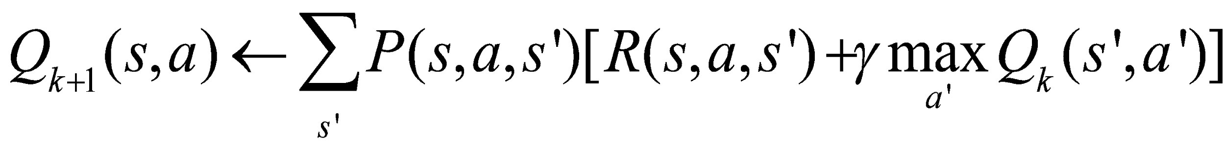
Q-Learning (Definition)
The key idea is to use Q(s,a) to represent the value of taking an action a in state s, rather than only the value of state U(s):
Define:
Optimal π(s) = argmax U^{π} (s) = argmax_{a} Q(s, a)
The last term using Q to replace U

Slide 72
Q-Learning (Algorithm)
Initially, let Q(s, a)=0, learning rate α
Sample a transition and reward (s,a,s’,r)
Sample = r + γ max_{a’} Q(s’,a’)
Q(s,a) = (1-α)Q(s,a) + α*Sample
r
a’
S’
s
a
Advantages:
No need for a fixed policy, can do off-policy learning, or directly learns a policy
The optimal policy π(s)=a is to select the action a that has the best Q(s, a)
Provably convergent to the optimal policy when t -> infinite

Slide 73
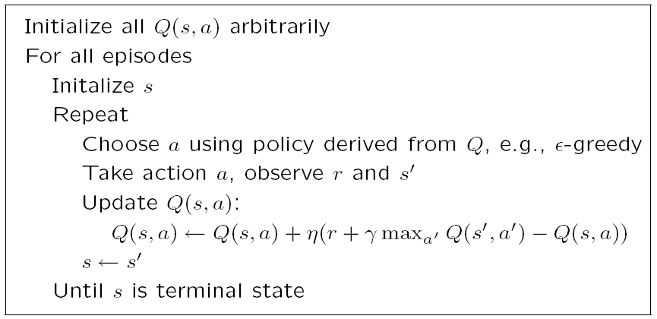
Q-Learning Algorithm

Slide 74
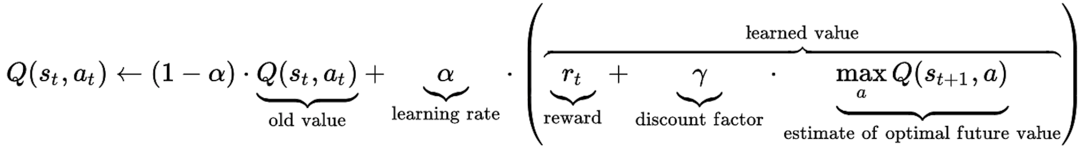
Q-Learning (in One Formula)

Slide 75
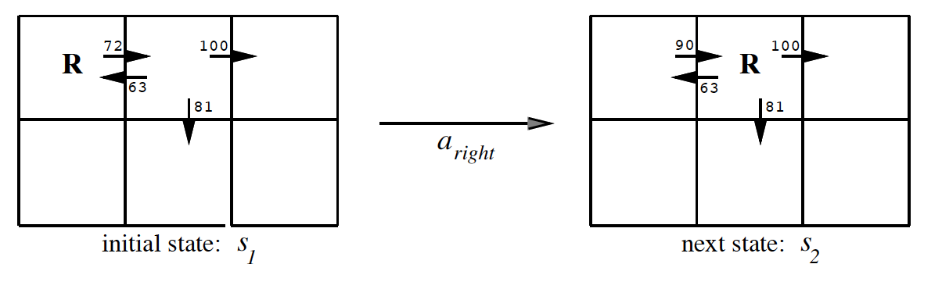
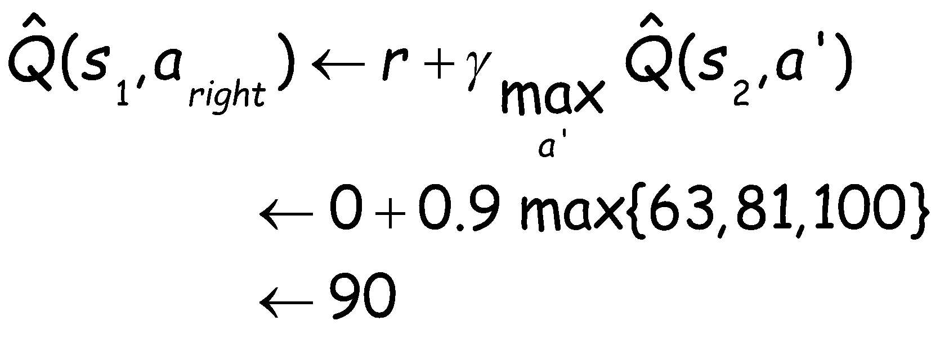
1-step Q-Learning Example
γ=0.9
Back-propagate Q-values 1-step backwards

Slide 76
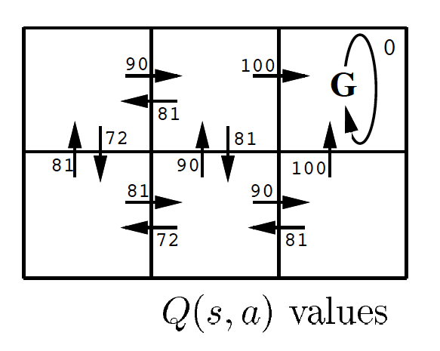
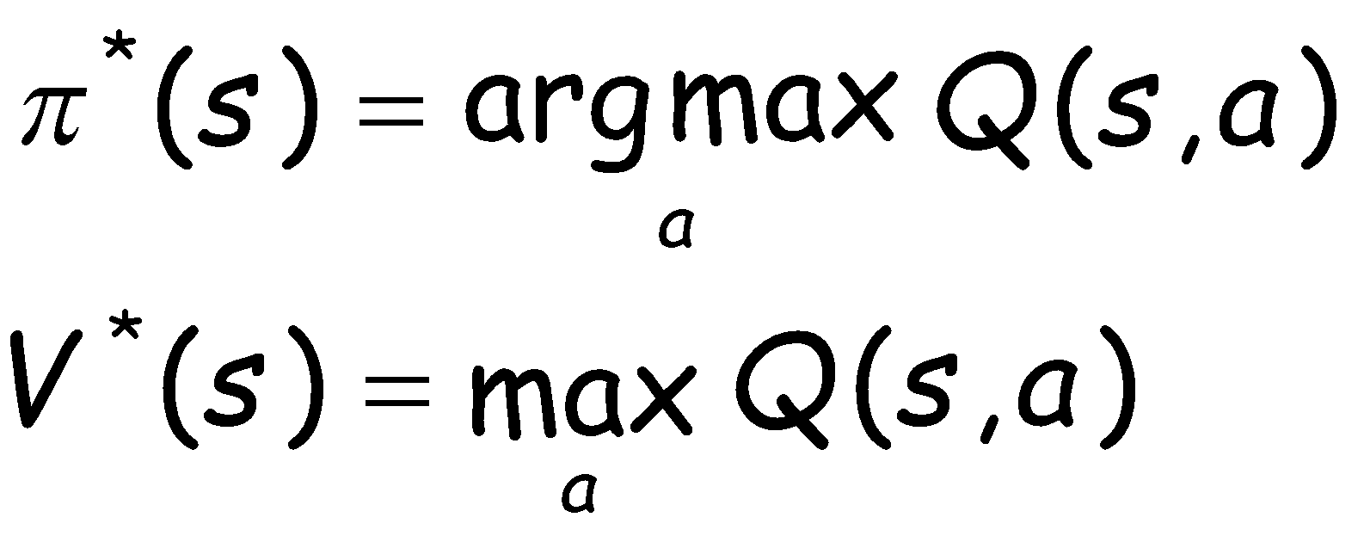
Q-Learning from state utility values
Q-Learning
Notice these

Slide 77
An Example for Q-Learning
Given
States: s₁, …, s_{n,}
Actions: a₁, a₂
Probabilistic transition model: (assume s_{n+1}=s₁)
P(s_{i},a₁,s_{i+1})=0.8, P(s_{i},a₁,s₁)=0.2, P(s_{i},a₂,s₁)=0.9, P(s_{i},a₁,s_{i+1})=0.1.
Reward: all R(s_{i}, a_{i}, s_{j}) = 0.0, except R(s_{n-1}, a₁, s_{n}) = 99.9
We define the goal state to be s_{n}
The learning rate α = 0.4
The Future discount factor: γ = 0.7
Try to learn: Q(s_{n-1},a₁), Q(s_{n-1},a₂), Q(s_{n-2},a₁), and Q(s_{n-2},a₂)=?
99.9

Slide 78
An Example for Q-Learning
Initially: all Q(s_{i}, a_{j}) = 0.0
Assume you got two samples at the state s_{n-1} for action a₁
s_{n-1},a₁, s_{n}, r=R(s_{n-1},a₁, s_{n})=99.9, // P(s_{n-1},a₁)🡪s_{n}
s_{n-1},a₁, s₁, r=R(s_{n-1},a₁, s₁)=0.0, // P(s_{n-1},a₁)🡪s₁
Updated Q value, if P(s,a) are known:
Q(s_{n-1},a₁)= 0.8*[99.9 + 0.7*0.0] + 0.2[0.0+0.7*0.0] = 79.9
If P(s,a) are unknown: sample₁ = 99.9+.7*0; sample₂=0+.7*0
Q(s_{n-1},a₁)= (1-0.4)*0.0 + 0.4*99.9 = 39.96
Q(s_{n-1},a₁)= (1-0.4)*39.96 + 0.4*0.0 = 23.976
99.9

Slide 79
Discussions of RL (1)
Pros:
Easy to use in problems where the data can be mapped to states easily
Guaranteed to find the optimal policy given enough time even with suboptimal actions
Cons:
States of the environment are not always known
Computation time is intractable for large or continuous state spaces
E.g. if each cell in a grid world is a state, then state space grows exponentially with number of rows and columns (states = map size = m*n)
Cannot handle raw data, must use an approximation/reduction function
Designing approximation functions to disambiguate similar states requires human intelligence or an alternate learning technique
E.g. use the relative distance (states = m*n) between two agents in a hunter-prey problem as opposed to their cell coordinates (states = m*n*m*n)
Model-free RL cannot transfer the learned knowledge when the goal changes
Forgetting a learned policy is much more difficult (hysteresis), quicker to start from scratch

Slide 80
Discussions of RL (2)
Utility function is unknown at the beginning
When agent visits each state, it receives a reward
Possibly negative
What function should it learn?
R(s): Utility-based agent
If it already knows the transition model
Then use MDP algorithm to solve for MEU actions
U(s,a): Q-learning agent
If it doesn’t already know the transition model
Then pick action that has highest U in current state
𝜋*(s): reflex agent
Learn a policy directly, then pick the action that the policy says

Slide 81
Q Learning Summary
Modify Bellman equation to learn Q values of actions
U(s) = R(s)+𝛾max_{a}∑_{s1}(P(s₁|s,a)U(s₁))
We don’t know R or P
But when we perform a’ in s, we move to s’ and receive R(s)
We want Q(s,a) = Expected utility of performing a in state s
Update Q after each step
If we get a good reward now, then increase Q
If we later get to a state with high Q, then increase Q here too
Q(s,a)← (1-⍺)Q(s,a) + ⍺(R(s)+𝛾 max_{a’}Q(s’,a’))
⍺ is the learning rate, 𝛾 is the discount factor
Converges to correct values if ⍺ decays over time
Similar to the “temperature” in simulated annealing

Slide 82
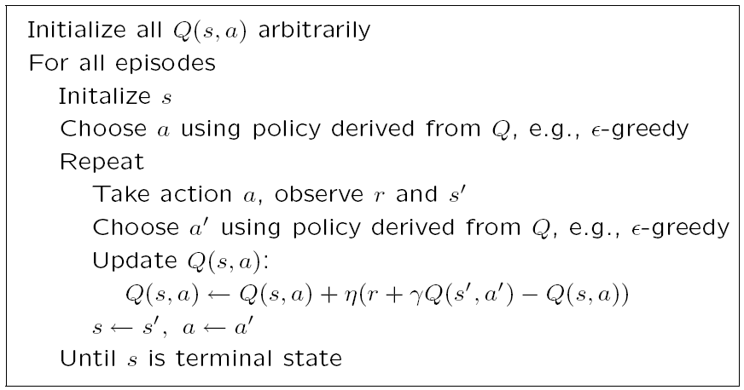
SARSA: State-Action-Reward-State-Action

Slide 83
Q Learning & SARSA
Converge to correct values
Assuming agent tries all actions, in all states, many times
Otherwise, there won’t be enough experience to learn Q
And if ⍺ decays over time
Similar to simulated annealing
Avoids the complexity of solving an MDP
MDP requires solving for the optimal policy before starting
An RL agent can start right away and then learn as it goes
Although this might be wasteful if you already know P and R

Slide 84
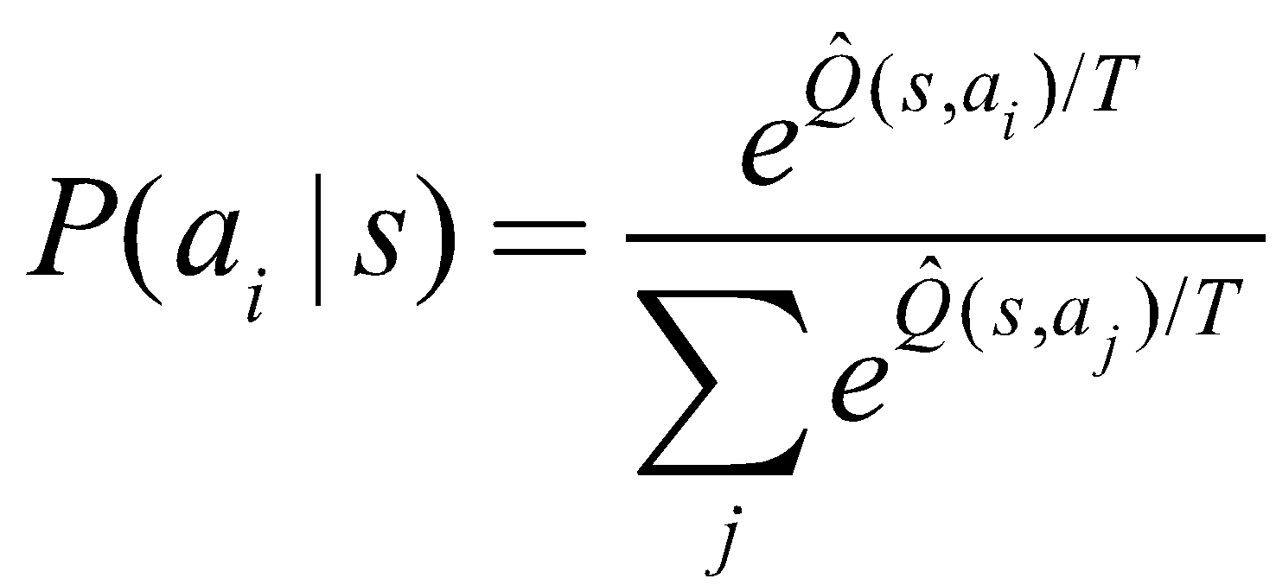
Exploitation vs. Exploration
RL algorithms do not specify how actions are chosen by the agent
One strategy would be in state s to select the action a that maximizes Q(s,a), thereby exploiting its current approximation Q.
Using this strategy the agent runs the risk that it will overcommit to actions that are found during early training to have high Q values, while failing to explore other actions that have even higher values.
It is common in Q learning to use a probabilistic approach to selecting actions.
Actions with higher Q values are assigned higher probabilities, but every action is assigned a nonzero probability. One way to assign such probabilities is where P(a_{i} |s) is the probability T of selecting action a_{i}, given that the agent is in state s, and where T > 0 is a constant that determines how strongly the selection favors actions with high Q values.

Slide 85
Exploitation vs. Exploration
Hence it is good to try new things now and then
If T is large, then more exploring,
If T is small, then exploit the current policy
One can decrease T over time to first explore, and then converge and exploit
For example T= c/k+d where k is iteration of the algorithm
Decreasing T over time is sometimes called simulated annealing, which is inspired by annealing process in metals. T is sometimes called the Temperature.

Slide 86
Conclusion
Reinforcement learning is alike to learning “on the fly”
Benefit/cost of decision is learned from exploring state space
We learn utilities to infer the reward of each action
We also learn policies to provide the most beneficial action while also allowing us to explore state space (thus reducing regret)

Slide 87
Appendix

Slide 88
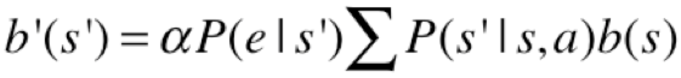
POMDP, Transitions, Belief States
A Partially Observable MDP (POMDP) is defined as follows:
A set of states S (with an initial state s₀)
A set of Actions: A(s) of actions in each state s
A transition model P(s’|s,a), or T(s,a,s’)
A reward function R(s), or R(s,a)
A sensor model P(e|s) 🡸
A belief of what the current state is b(s) 🡸
Belief States (where am I now? What is my current state?):
If b(s) was the previous belief state, and the robot does action “a” and then perceives a new evidence “e”, then the new belief state: where α is a normalization constant making the belief states sum to 1

Slide 89
Goals, Rewards, Utilities, Policies
Goals
Given to the agent from the problem statements
Rewards
Given to the agent, designed based on the goals
Utility values for states
Computed by the agent, based on the rewards
Policies
Computed or learned by the agent
Used by the agent to select its actions
The better a policy, the more rewards it collects

Slide 90
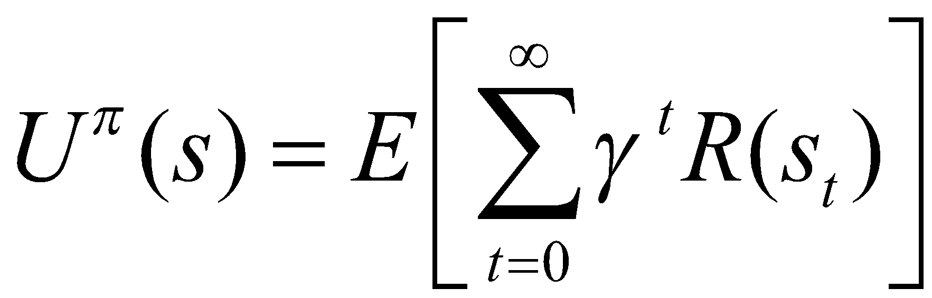
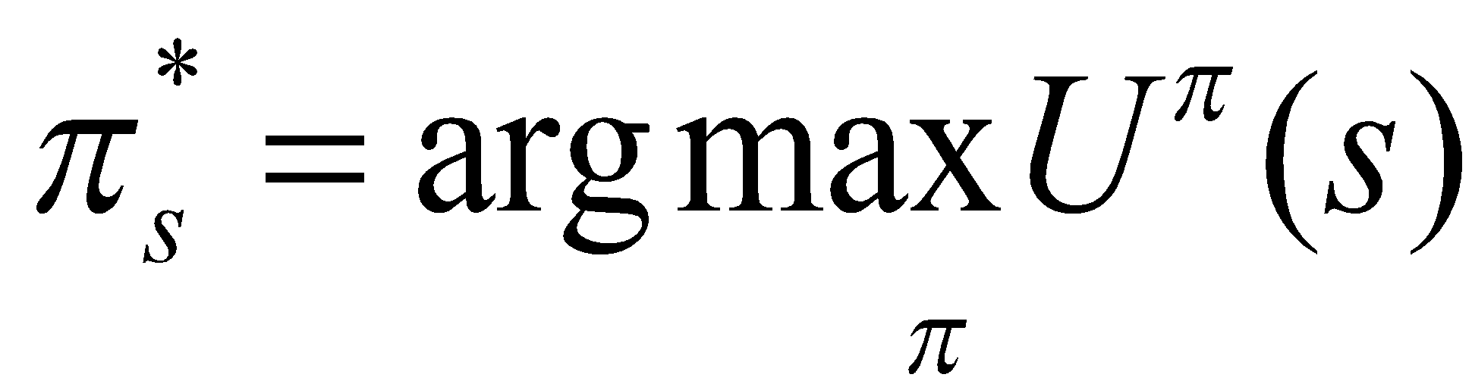
Compute Utilities from Rewards over Time
Future Rewards
Add the rewards as they are
Discount the far-away rewards
The expected future utility value U^{π}(s) obtained by executing a policy π starting from s
The Optimal Policy

Slide 91
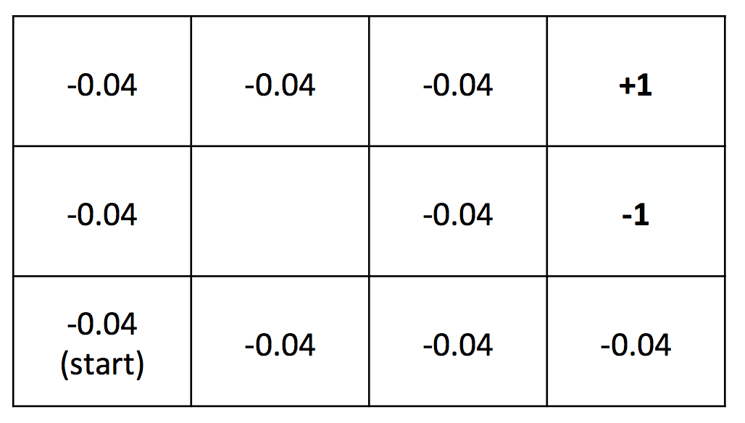
Compute Utilities (example)
0.812 | 0.868 | 0.918 | +1
0.762 |  | 0.660 | -1
0.705 | 0.655 | 0.611 | 0.388
Rewards (given)
Utilities (computed)
Given the rewards in all nonterminal state are R(s) = - 0.04,
Compute utilities using a future discount γ = 1
(we will see how these utilities are computed)

Slide 92
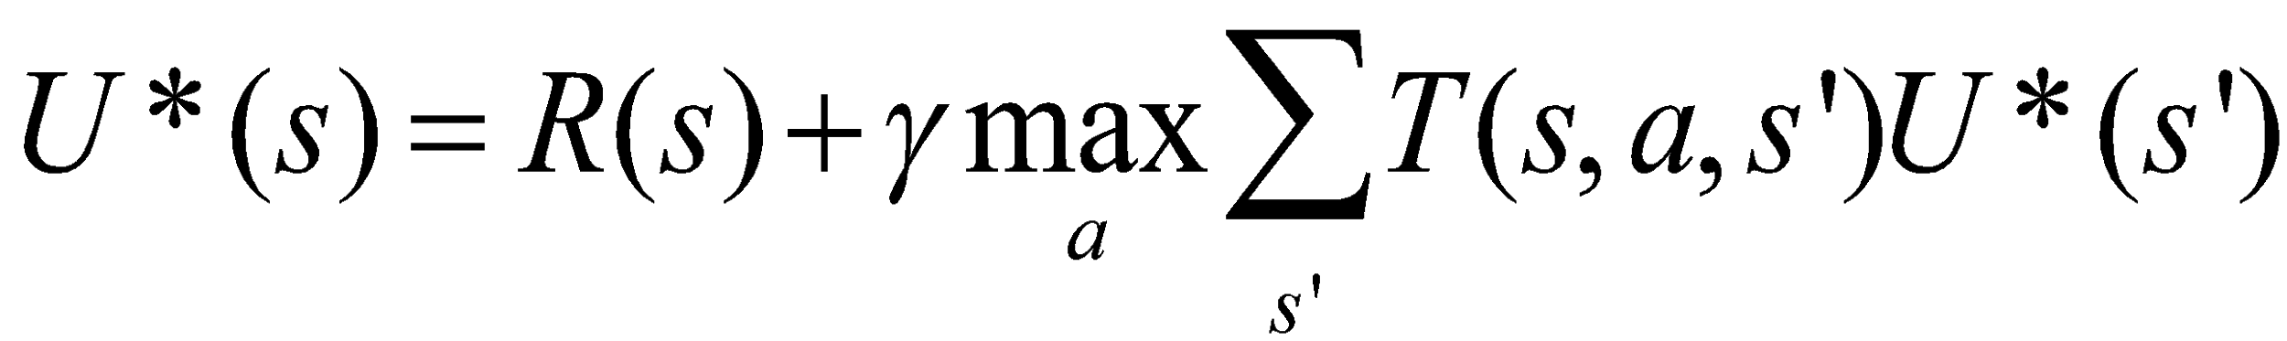
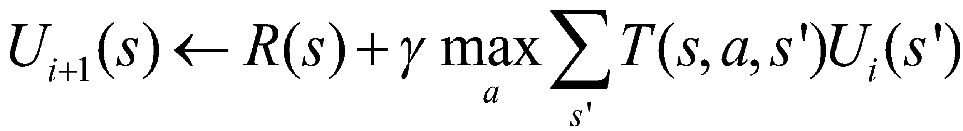
State Utility Value Iteration (improving U(s) every step)
U(s): the expected sum of maximum rewards achievable starting from a particular state s
Bellman equations:
For n states, there are n equations must be solved simultaneously
Bellman iteration:
Converge to U*(s) step by step
(17.5)
(17.6)

Slide 93
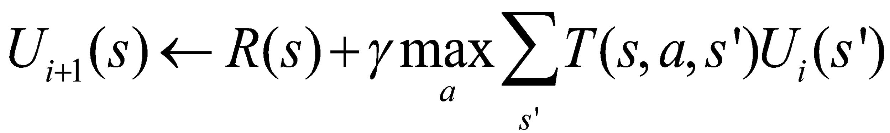

Bellman Iteration Example
The Initial Utilities
Reward R(s)
0.0 | 0.0 | 0.0 | 0.0
0.0 |  | 0.0 | 0.0
0.0 | 0.0 | 0.0 | 0.0
-0.04 | -0.04 | -0.04 | +1
-0.04 |  | -0.04 | -1
-0.04 | -0.04 | -0.04 | -0.04
Transaction probability T(s, a, s’) = 0.8 for intended, 0.2 for sideways
Discount Gamma = 1.0
0.812 | 0.868 | 0.918 | +1
0.762 |  | 0.660 | -1
0.705 | 0.655 | 0.611 | 0.388
The Finial Utility Values

Slide 94

Utility Value Iteration for POMDP
In MDP, utility value iteration, when sensors are certain, we know the next state s’
In POMDP, where sensors are uncertain, we must average over all possible evidences for the next state s’ (see the last term below):

Slide 95
Policy and Optimal Policy
A solution of (PO)MDP can be represented as
A Policy π(s)=a
Each execution of policy from s₀ may yield a different history or path due to the probabilistic nature of the transition model
An optimal policy π*(s) is a policy that yields the highest expected utility

Slide 96
Policy Based on Known Utility Values
0.812 | 0.868 | 0.918 | +1
0.762 |  | 0.660 | -1
0.705 | 0.655 | 0.611 | 0.388
Suppose we know the utility values of the states as above,
What path would an optimal policy would choose?
Rewards 🡪 Utilities Values 🡪 Policies

Slide 97

Optimal Policy Examples Depending on Reward distribution R(s)
If the rewards for the nonterminal states are evenly distributed (e.g., -0.04), then the path chosen will depend on the probabilities of the transition model
🡪 | 🡪 | 🡪 | +1
^ |  | ^ | -1
^ | 🡨 | 🡨 | 🡨
3
Nonterminal R(s)= - 0.04
2
1
1
2
3
4
Caution: because the nondeterministic actions, from state (3,2) or (4,1),
you may “accidentally” go to (4,2). So there is a “risk” in this policy.

Slide 98
Optimal Policy Examples Depending on the reward distribution R(s)
🡪 | 🡪 | 🡪 | +1
^ |  | 🡪 | -1
🡪 | 🡪 | 🡪 | ^
🡪 | 🡪 | 🡪 | +1
^ |  | ^ | -1
^ | 🡪 | ^ | 🡨
Nonterminal rewards R(s)=-0.04
suicide
risky
🡪 | 🡪 | 🡪 | +1
^ |  | ^ | -1
^ | 🡨 | 🡨 | 🡨
R(s)<-1.6284
(life is painful, death is good)
-0.4278 < R(s)<-0.0850
(life is OK, willing to risk)
🡪 | 🡪 | 🡪 | +1
^ |  | 🡨 | -1
^ | 🡨 | 🡨 | 🡨
❖ | ❖ | 🡨 | +1
❖ |  | 🡨 | -1
❖ | ❖ | ❖ | V
end nicely
don’t end
?
Why not go up?
no risk
no risk
risky
no risk
Hint: Consider the nature of actions, deterministic or not
Go up is “risky”
-0.0221<R(s)<0
(life is good, minimize risks, willing to end nicely)
R(s)>0
(life is rewarding,
I don’t want to end it)

Slide 99

Optimal Policy
You can compute it once after U*(s) is known
Or, you can compute it incrementally every iteration when U_{i}(s) is updated
This is called “Policy Iteration” (see the next slide)

Slide 100

Policy Iteration (improving π(s) every step)
Start with a randomly chosen initial policy π₀
Iterate until no change in utility values of the state:
Policy evaluation: given a policy π_{i}, calculate the utility U_{i}(s) of every state s using policy π_{i} by solving the system of equations:
Policy improvement: calculate the new policy π_{i+1} using one‐step look‐ahead based on U_{i}(s):

Slide 101
Policy Iteration Comments
Each step of policy iteration is guaranteed to strictly improve the policy at some state when improvement of state utility value is possible
Converge to the optimal policy
Gives the exact value of the optimal policy

Slide 102

Policy Iteration Example

Slide 103

Policy Iteration Example

Slide 104

Policy Iteration Example

Slide 105

Policy Iteration Example

Slide 106

Policy Iteration Example

Slide 107

Policy Iteration Example

Slide 108
Policy Iteration Example
The new policy π₂ after an iteration from π₁
π₂(Hungry)🡪Eat
π₂(Full)🡪Sleep

Slide 109
Summary
POMDP is very (the most) general model
Deal with uncertainty by
action models and sensor models
Incorporate goals 🡪 rewards 🡪 utilities 🡪 policy
Utilities and policies can be computed from rewards
Systematically (Bellman equations)
Iteratively (Bellman’s iteration algorithm)
Solve a problem by following a good policy
One policy for one problem

